Slide 1
PGCERT -
MICROTEACHING:
USING PODCASTS

Slide 2
What is a podcast?
Designer
The dictionary definition of a podcast is:
A digital audio file made available on the Internet for downloading to a computer or mobile device, typically available as a series, new instalments of which can be received by subscribers automatically.
The term Podcast is actually a portmanteau/mixture of iPod and Broadcast.
CLICK TO CONTINUE

Slide 3
What is a podcast?
Designer
What podcasts do you listen to?
Why?
CLICK TO CONTINUE

Slide 4
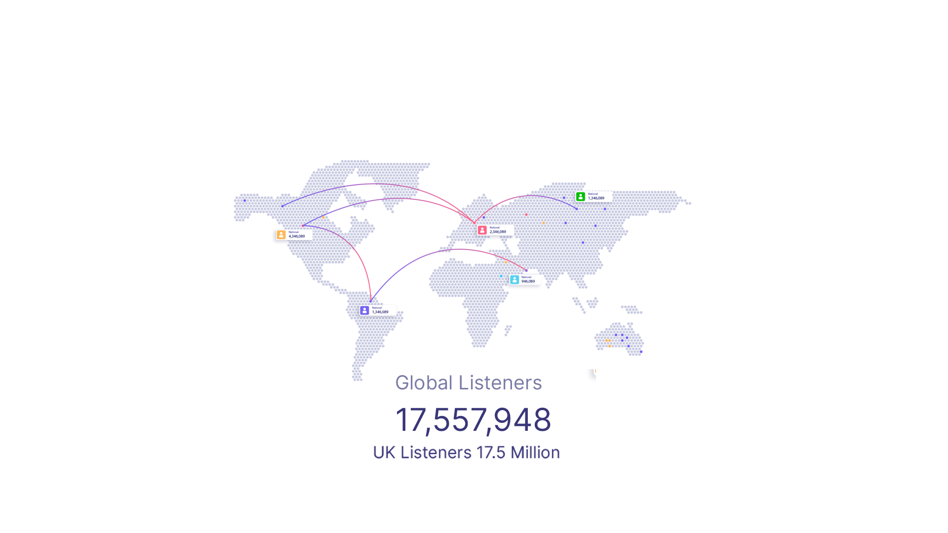
Why use a podcast?
Designer
Over 17.5 million people listen to podcasts last year in the UK with the 2 most popular being Joe Rogan and Steven Barlett
CLICK TO CONTINUE

Slide 5
Why use a podcast?
Designer
A study into Podcasting as an educational tool entitled: Pedagogy, Podcasts, and Politics: What Role Does Podcasting Have in Planning Education? published in 2022 by Thomas Moore provided many positive conclusions such as enhancing student engagement, stating that podcasts are argued to present “exciting prospects for authentic learning and assessment” situated in wider contexts relevant to the field of study. As well as overcoming issues around inclusivity. The paper also went on to cite that providing institutional support could overcome issues of unfamiliarity, access, and resource constraint that may affect student engagement.
CLICK TO CONTINUE

Slide 6
Planning
a podcast
Designer
1. Where to start
2. What to podcast about
3. What equipment to use
4. How to publish your podcast
CLICK TO CONTINUE

Slide 7
Designer
What do you want
to podcast about?
We are going to create a list of ideas so that you can choose one that:
You will have plenty of content for
You're interested in
There is an audience for
To get things started, ask yourself:
What are some things I already like to learn about?
What would I pay to learn if I could afford it?
What do I wish existed?
CLICK TO CONTINUE

Slide 8
Designer
What do you want to
to podcast about?
Make a list of:
Skills you've developed
Knowledge you've acquired
Challenges you've overcome
CLICK TO CONTINUE

Slide 9
What to
podcast about?
Designer
Some tips to help you get started are:
1. Think about what other people struggle with (what do your friends, family & colleagues complain about that you do easily)
2. What do people compliment you on? (feel free to ask your friends)
3. How do you people introduce you to others? What do they say you’re great at?
4. What would you do if you had an extra 3 hours free? What would you talk about with a friend for 3 hours?
5. Use your current platform (Insta/Twitter/TikTok)
5. What do you do on a Saturday afternoon?
6. What are you excited about?
7. What do other people do that you think is cool or interesting?
CLICK TO CONTINUE

Slide 10
Designer
What to podcast about?
Now decide on one "broad topic”
CLICK TO CONTINUE

Slide 11
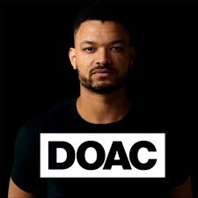
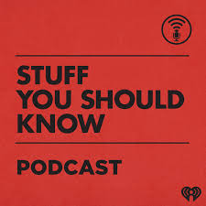
Example Podcasts
Designer
CLICK TO CONTINUE

Slide 12
Designer
Planning your episodes
Based on the broad topic chosen, go on to do a little research.
We are looking for more specific episode and topic ideas.
Ideas to help you get started with your research:
Amazon reviews: 2-4 star will get more thoughtful feedback
Amazon books: look in the table of contents
Google, search for top blogs on your topic
Podcast reviews of existing podcasts on your topic
Q&A sites: Reddit, Quora, etc.
Forums
Talk to people
CLICK TO CONTINUE

Slide 13
Designer
Planning your episodes
If you're planning on doing an interview-style show, research people you'd like to interview.
A few places to look are:
Podcasts (hosts or guests)
Expert "round-up" blog posts
Authors of books or articles (online or in print)
Schools (professors and teachers)
Businesses owners
Write down a list of 10+ episode ideas. In addition, could you easily come up with at least 100 different episode or topic ideas?
CLICK TO CONTINUE

Slide 14
Designer
Choosing a Name
If you look at the Apple Podcasts / Youtube charts, you’ll see a variety of different names.
Some are descriptive of what the show is about, while others don’t mean much.
Choose a name that leans more broad, like your topic idea. That way you don’t pigeonhole yourself into something that you may get bored of or run out of content for.
You can always be more specific in your subtitle.
Another great way to go is to use your name (i.e. The Tim Ferriss Show) - lots of successful shows have gone this route.
CLICK TO CONTINUE

Slide 15
Designer
Show Format
There are many different styles and formats you can choose - and many people will combine formats (i.e. a solo episode one day, an interview episode another day).
There isn't a right or wrong way to go here - and many shows evolve and change over time to include other formats or segments.
Key takeaway:
Your listener will take 5-10 seconds to decide if they are going to listen further so make sure they know who you are, what your show is about and what authority the guests on your show have to speak about the subject!
CLICK TO CONTINUE

Slide 16
Designer
SCRIPTS
· Having a script will make your production sound more focused, produced, and polished
· A script should be invisible.
Conversational writing needs to sound natural, not stilted and artificial.
· Write for the ear, not the eye.
· Write clearly.
· Build a connection.
· Pay attention to rhythm
CLICK TO CONTINUE

Slide 17
Designer
Tasks
You are now going to record a 2 min podcast!
Pick a subject (1 min)
Create questions for your guest (2 min)
Record the podcast using the sample script (4 min)
Listen Back (2 min)
You have 10 mins in total!
CLICK TO CONTINUE

Slide 18
Designer
Sample Script
Intro:
Host: Welcome to (insert title) the Podcast about (insert subject)
Host: This episodes topic is (Insert brief synopsis) and my special guest joining us is (Name) who is (quantifier)
CLICK TO CONTINUE

Slide 19
Designer
Podcast Cover Art
Podcast cover art is kind of like a book cover (with less space). Your main goals should be to:
Stand out
Be easy to read (at different sizes)
Be easy to understand what your show is about
Get people to click and learn more
CLICK TO CONTINUE

Slide 20
Designer
Recording
CLICK TO CONTINUE

Slide 21
Designer
Microphones and equipment
CLICK TO CONTINUE

Slide 22
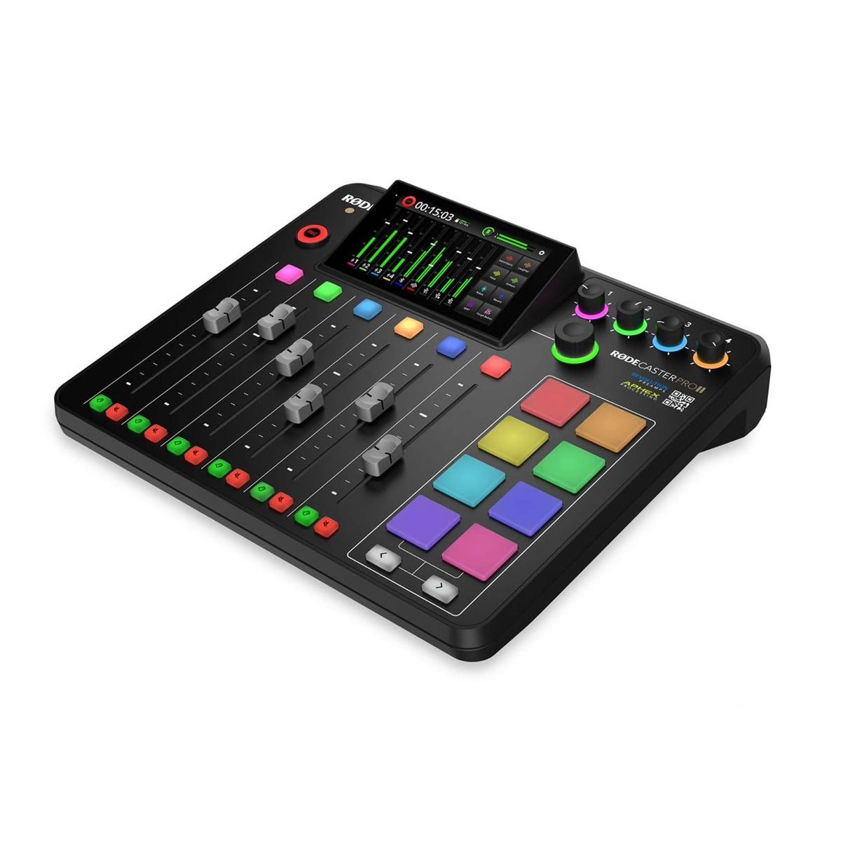
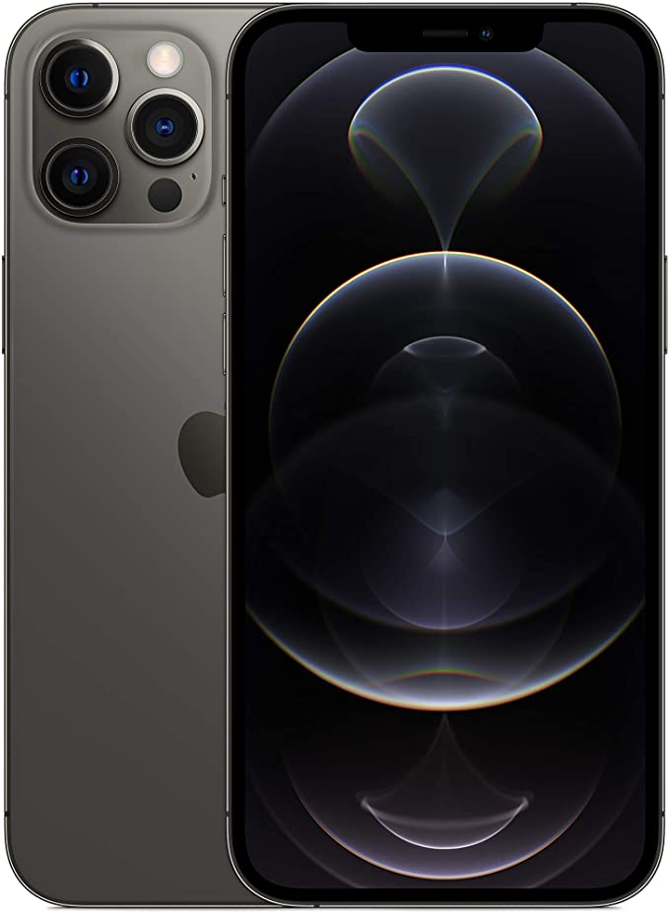
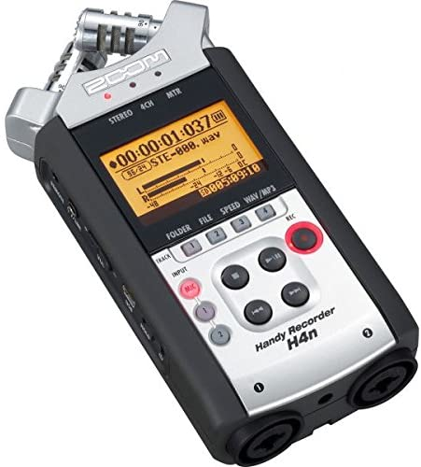
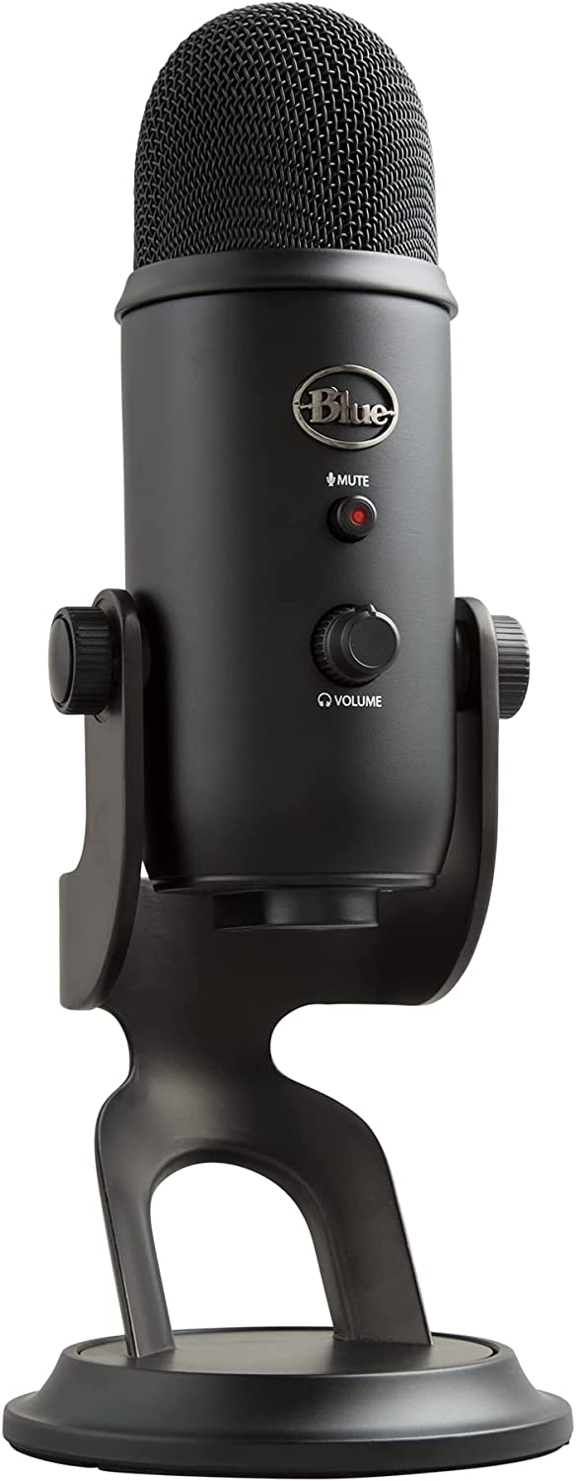
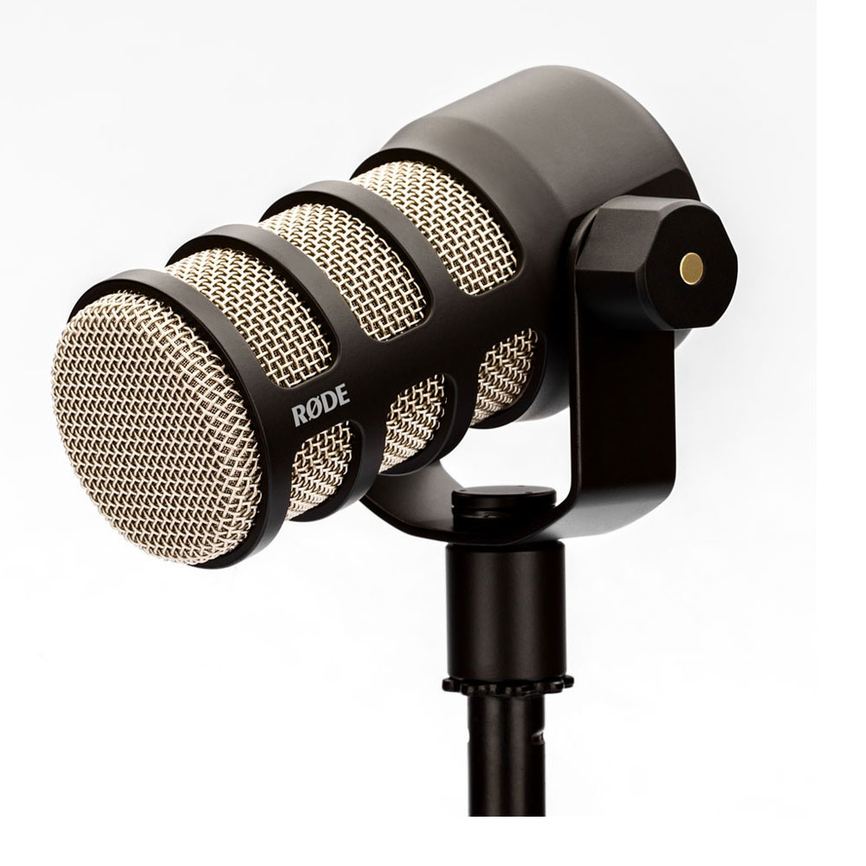
Hardware for Recording Podcasts
Designer
CLICK TO CONTINUE

Slide 23
Software for Recording Podcasts
Designer
CLICK TO CONTINUE
AUDACITY
CROSS PLATFORM
GARAGE BAND
MAC
ADOBE AUDITION
CROSS PLATFORM

Slide 24
Designer
Publishing
CLICK TO CONTINUE

Slide 25
Designer
Podcast Publishing
CLICK TO CONTINUE
Anchor.fm
Apple Podcasts
Spotify

Slide 26
THANK YOU!
@socializemedia

